Slide 1

IPM Knowledge
Put to Use
Charles Mellinger, PhD
Presented by Christian Miller, DPM
Glades Crop Care, Inc.
March 28, 2012

Slide 2
Today’s Talk
Goal: to describe how IPM knowledge is used at Glades Crop Care.
Talk’s bias: the IPM content of our program is viewed from a business standpoint (IPM=“profitableness”).
Talk’s perspective: commercial vegetable farm but can be adapted to other systems, e.g., forest, nursery, urban, etc.

Slide 3
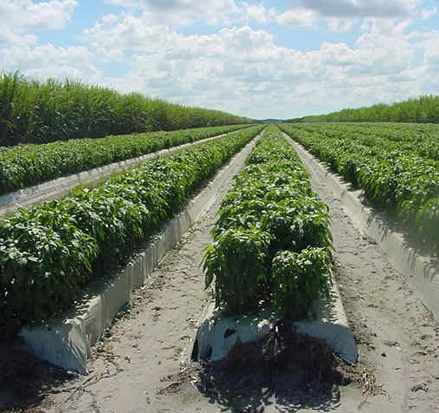
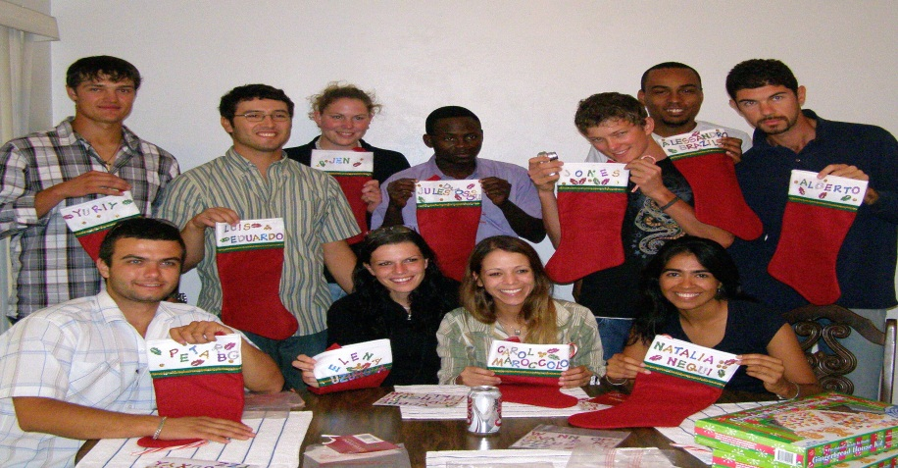
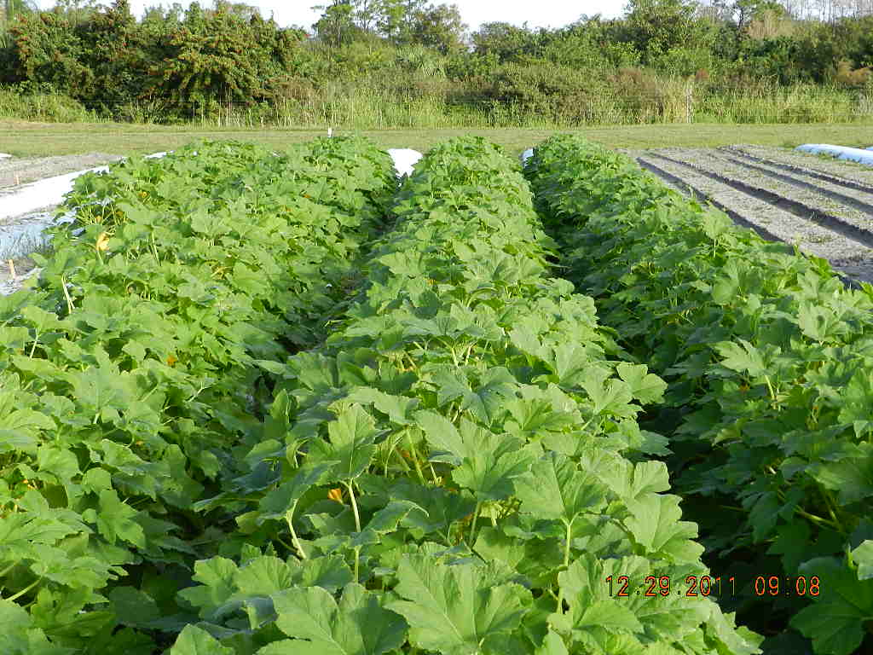
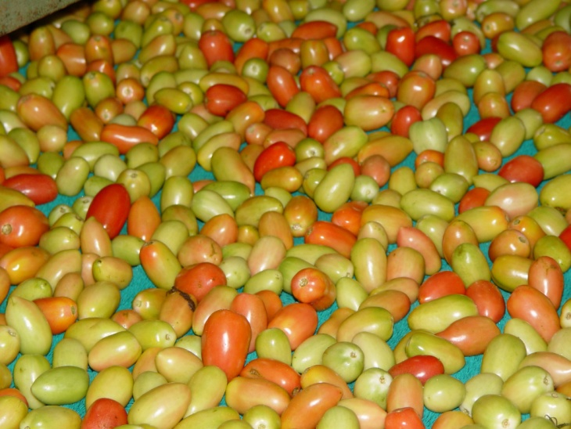
WHO IS GCC?

Slide 4
Working Together at GCC
Team of fantastic individuals
An independent crop consultant company
(30 professional staff)
Serves fresh vegetable/fruit growers in 4 SE
states (40 crops/65,000 acres)
Services: IPM scouting/consulting; food safety auditing/consulting; contract research
Education/Certification: 4 DPM, 1 PhD, 4 MS,
19 BA/S, 1 NAICC, 4 CCA, and 1 ARPACs

Slide 5
IPM Program—4 Main Parts
1. Observations
2. Interpretations
3. Action (or delayed action)
4. Communications

Slide 6
Observations Level 1
Individual Pests
Individual Level: Understanding Pests
  Learn the basics: 50 to 250 plus pests, characteristic symptoms of diseases, abiotic characteristics, weeds, life cycles, crop stages etc.
  Learn where to find advice, e.g., specialists and other resources
Distinguish:
  1st instar TFW from 1st instar FAW
  4 whitefly species and vectored viruses
  Up to 5 aphids species
  Young lesions of early blight from bacterial spot
  Parasitized and active leaf miner larvae

Slide 7
Observations Level 2
Pest Population(s)
Field/crop/blocks/greenhouse
Role of Sampling: created or adapted sampling systems (size, number, pattern, tools, other aids
Key development: can be clearest way to assess
and communicate.
Environmental factors and production practices
Fallow fields, cull piles, surrounding vegetation
Reservoirs for all pests, inoculum sources for farm
Ponds (water sources)

Slide 8
Observations Level 3
Landscape Level
Landscape, Areawide, Regional
In GCC’s case, this means sharing observations with competing farms.
Convincing growers their competitive advantage was not in perfect timing with whitefly spraying but based on areawide management. They may not have to spray for whiteflies at all. This worked!
IPM program content is more of the same plus inter-grower communication, map making and distribution, and communication; always promoting trust.
Programs addressing problems on different scales may require significant funding through research grants.

Slide 9


Survey Location
Future Expansion
Current Locations

Slide 10
Lee
Hendry
Collier

Slide 11
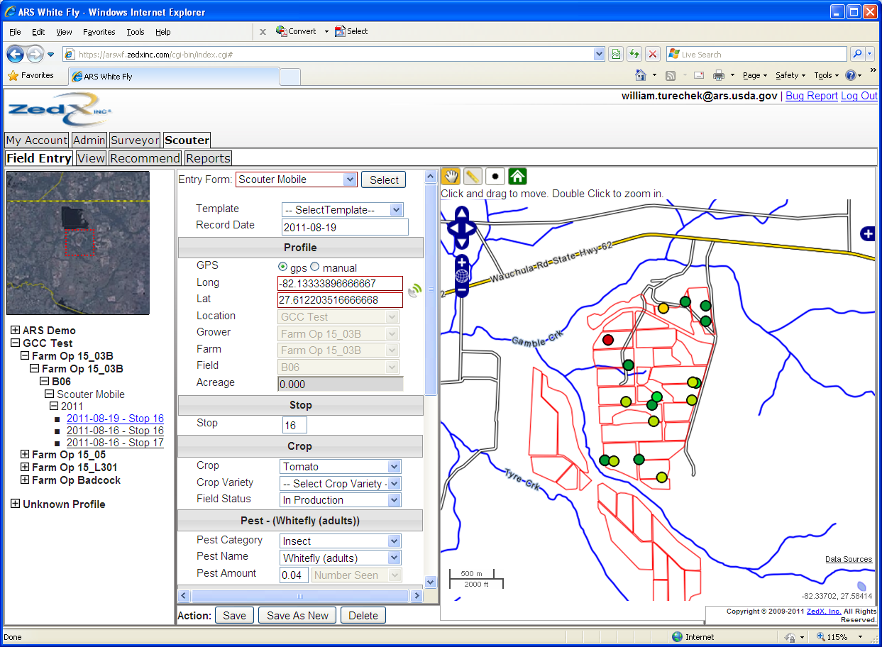


Slide 12
Interpretation of Observations
Learning when your observations call for an action (determining a threshold or some other key has been exceeded)
Damage estimates
Thresholds- vary with growers
Parasitism levels (kind of a threshold)
Ratios- Orius & thrips
Positive laboratory test results
Vector identification
Developing an eye for healthy vs. ‘not’ healthy (recognizing/suspecting that growth isn’t normal, leading to further investigation and problem solving)

Slide 13
Interpretation
Decision-making
Decisions can be simple- apply a pesticide
Decisions can be complex- involving evaluation of a wide range of inputs that enter into the decision.
Decision makers need to know-
Pesticide rates, PHIs,REIs, rotations, max/crop
Biologicals- how and when do they fit?
Resistance management- how to keep pesticides working (crucial)
Environmental impacts
Impact of production practices
GIS/GPS, areawide data
Field trials as necessary
Delay Action?

Slide 14
Communication
How to discuss recommendations with clients- written, oral
Maintaining records
Professionalism
Resources- Land Grants/Extension, USDA, colleagues

Slide 15
Other IPM Content
WPS & Food Safety
Important for fresh fruits and vegetables
Food Safety
  We carry out FS observations and report during routine scouting
  75% of our food safety program has IPM content
  Environmental Concerns About Pesticides
  Workers
  Scouts
  Environment

Slide 16
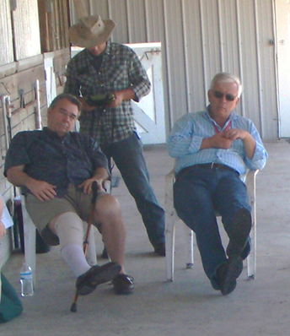
To all my colleagues at Glades Crop Care over the years that drove the development of this IPM program
Thank you!

